Slide 1


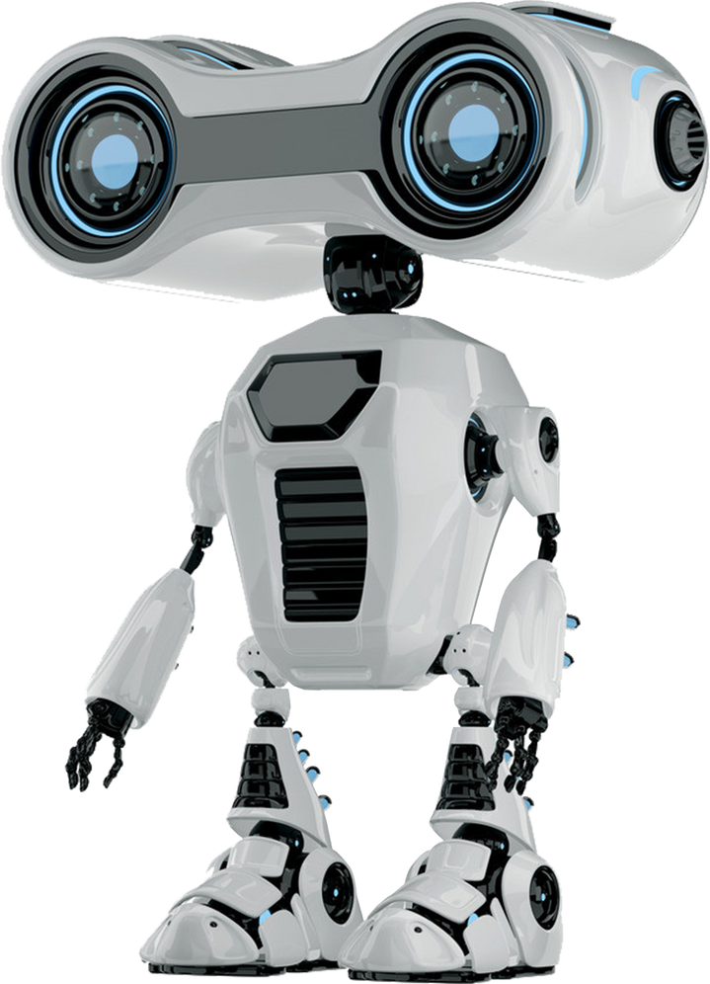

SQL Chatbot
Microsoft Machine learning track

Slide 2




Agenda:
Project Overview Problem Statement Challenges
System Architecture LLM Trad-offs Frameworks trade-offs Development
Full app
Result and Impact Code Results

Slide 3


Project Overview
This project introduces an innovative automated Text-to-SQL system that empowers users to interact with their data through simple natural language queries. The goal is to make data access effortless for non-technical users by automatically converting their questions into queries that retrieve relevant information from the database. This eliminates the need for specialized technical knowledge, making the data accessible to a broader audience.

Slide 4

Problem Statement 1
Businesses and organizations often store vast amounts of data in relational databases. Accessing and querying this data traditionally requires knowledge of SQL ( Structured Query Language), which limits access to non-technical users. As data continues to grow in complexity and size, it's crucial to have systems that allow for easy and efficient data access.

Slide 5


Challenges
Barrier to Entry for Non-Technical Users: Writing SQL queries requires specialized skills, limiting the ability of non-technical users (like business analysts, managers, etc.) to extract meaningful insights from the data.
Complexity of Query Optimization: Writing efficient SQL queries that minimize data scanning costs (in systems like BigQuery) and return results quickly requires expertise in both SQL and the specific database system.
Error Handling in Query Execution: Detecting and correcting these errors can be
difficult, especially for users without a deep understanding of SQL.
Dynamic Data and Schema Changes: The structure of a database (its schema) can change over time. Keeping track of these changes and ensuring queries remain valid can be a challenge, especially in large organizations with multiple data sources.

Slide 6





System Architecture
Understanding User Requirements
System Architecture
Natural Language Processing
Query Generation
Query Execution & Optimization
Error Handling & correction

Slide 7











1- Understanding User Requirements:
We began by analyzing common challenges faced by non- technical users when interacting with databases, focusing on how to simplify data access through natural language input.

Slide 8



2- System Architecture:
The system was structured to efficiently translate user questions into database queries. This involved creating a framework that understands both the user's intent and the underlying database schema.

Slide 9
3- Natural Language Processing:
A core part of the methodology involved developing a mechanism to interpret user queries written in plain language, ensuring that the system could accurately comprehend a variety of questions.

Slide 10
4- Query Generation:
We implemented methods to dynamically retrieve and analyze the database structure, ensuring the generated queries align with the available data.

Slide 11
5- Query Execution and Optimization:
Once the queries were generated, the system was designed to optimize them, reducing data retrieval costs and improving performance. The queries were run efficiently, retrieving only the necessary information.

Slide 12
6- Error Handling and Correction:
The methodology included a system for validating and correcting SQL queries before and after execution, ensuring that any issues were automatically addressed and the user received accurate results.

Slide 13

Frameworks Trade-offs
A Large Language Model (LLM) and SQL databases are required to develop the system, but The whole difficulty lies in how to communicate between the NLP stage and Query Generation Therefore, they must both search for a link between them, and indeed there were several
approaches.
Graph RAG with Neo4j:
Transforming a large-scale relational database into
a graph structure was not straightforward, given the LangChain:
size and complexity of the data. Additionally, Neo4j's environment didn’t work smoothly on Windows.
LangGraph Cyclic Graph:
The LangGraph framework has several environment
It offered a well-supported,
modular environment with a strong
community. It integrates smoothly with our chosen tools and scales well for large database interactions.
dependencies and lacks a large, supportive community, making it more challenging to implement and troubleshoot effectively.

Slide 14



LLM Trade-offs
When choosing a Large Language Model (LLM), there are several important factors to balance:
Accuracy vs. Speed: Gemini-1.5 Flash offers high precision for generating SQL queries, ensuring your outputs are reliable while also being quick to
execute.
Cost-Efficiency: It's a powerful model that balances performance and resource usage, making it cost-effective compared to larger models.
By choosing Gemini-1.5 Flash, we
prioritized a model that is fast,
accurate, and efficient—perfect for you
project's needs without overburdening resources or budget.
Consistency: With a temperature set to 0.0, it provides consistent, deterministic outputs, which is essential for structured tasks like SQL generation.

Slide 15

Development
https://colab.research.google.com/drive/1AlUeH6kmogaMCpQzgJyTSU6WHizSc_XL?usp=sharing#scrollTo=sDfJTTCUJVrY

Slide 16

Result and Impact

Slide 17
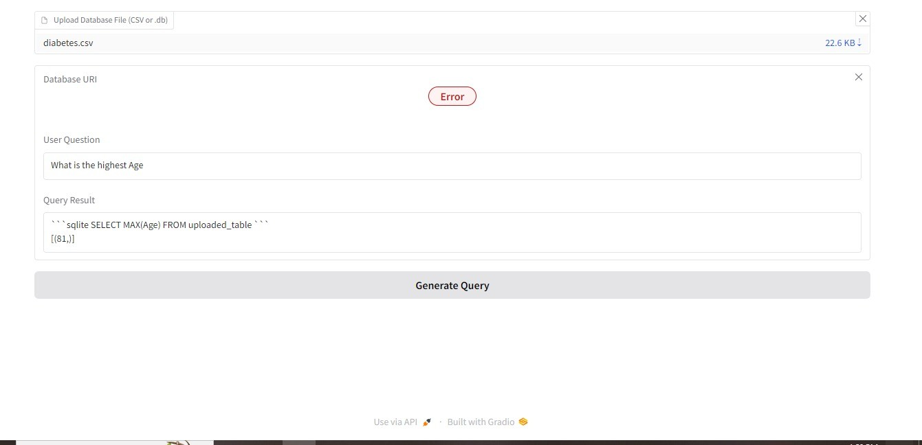
Deployment

Slide 18
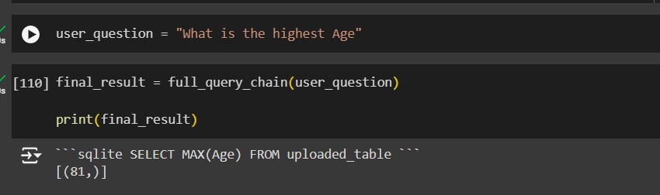
Code Results :

Slide 19

THANK
YOU

